Slide 1
FINANCIAL MARKETS AND INSTITUTIONS
Nguyen Thu Hang
nguyenthuhang.cs2@ftu.edu.vn

Slide 2
Course materials
1. Mishkin & Eakins, Financial Markets+ Institutions, 9e (Ch1-10)
2. Madura, Financial Institutions and Markets. (Ch1-14)
3. Mishkin, The economics of Money, Banking and Financial Markets (Ch1-8)
3. Hull, Options, Futures and other Derivatives, Ch1
4. Berk DeMarzo, Corporate Finance (Ch4, 5,6)
5. CFA Curriculum, L1B5, Equity and Fixed Income

Slide 3
Assessment
Performance: 10%
Mid-term test : 30%
Final exam: 60%

Slide 4
Outline
Chapter 1: Overview of Financial Markets and Institutions
Chapter 2: Interest Rates
Chapter 3: Money Markets
Chapter 4: Bond Markets
Chapter 5: Mortgage Markets
Chapter 6: The Stock Market
Chapter 7: Derivatives Markets

Slide 5
CHAPTER 1
OVERVIEW OF FINANCIAL MARKETS AND INSTITUTIONS

Slide 6
Outline
Overview of financial system and financial markets
Structure of financial markets
Financial Intermediaries
Ref: Mishkin & Eakins, Financial Markets+Institutions (Ch1, 2)
Mishkin, The economics of Money, Banking and Financial Markets (Ch1,2,8)
Notes:
intermediaries

Slide 7
Financial system
The Financial System
Public Finance
Financial Market
Financial Institutions
Business Finance
Personal Finance

Slide 8
Financial system (cont.)
Public Finance (TCH431)
Government operations to implement policy.
Efficient resources allocation, income distribution and economic stabilization.
Business Finance (TCH321)
Business operations to maximize owner’s wealth.
Investing and financing decisions.
Personal Finance
Individual or family activities.
Maximize utilities.

Slide 9
Financial system (cont.)
Internal Finance: Reinvest the cash-flows generated within the families, firms,...
Some households/firms/governments/sectors are in budget deficit. Others have a budget surplus.
External Finance: Ones with budget deficits seek for outside sources of capital from those with budget surpluses by the means of direct finance and indirect finance.

Slide 10
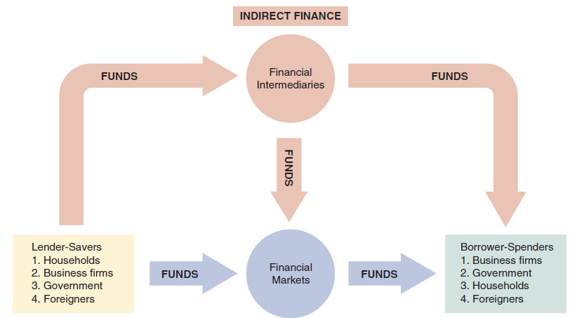
Capital Movements in the Financial System
(Refer: Mishkin 7th Chapter 2)

Slide 11
Capital Movements in the Financial System
Direct finance: borrowers issue securities to borrow funds directly from the lenders: bond market, stock market, money market, foreign exchange market,…
Indirect finance: financial intermediaries channel funds from lenders to borrowers: commercial banks, insurance companies, finance companies, mutual funds, pension funds,…
Function: Channels and allocates funds efficiently from savers to spenders, across economic sectors and geographical areas.

Slide 12
Financial Markets
Financial markets facilitate financing and investing by households, firms, and government agencies.
A financial market is a market in which financial assets (securities) can be purchased or sold

Slide 13
Financial markets
Financial markets are factor markets (capital).
Function
Channel funds from saving to investment.
Determine prices of financial instruments.
Reduce information cost, search cost.
Create liquidity.
Government implements its economic policy.
(Refer: Mishkin 7th Chapter 2; Madura 9th Chapter 1)

Slide 14
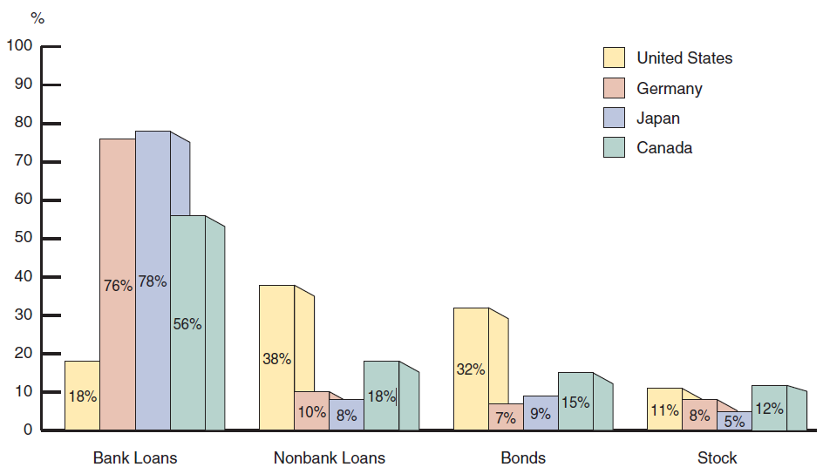
Sources of External Funds for Nonfinancial Businesses (Refer: Miskin 7th Chapter 7)
Notes:
.

Slide 15
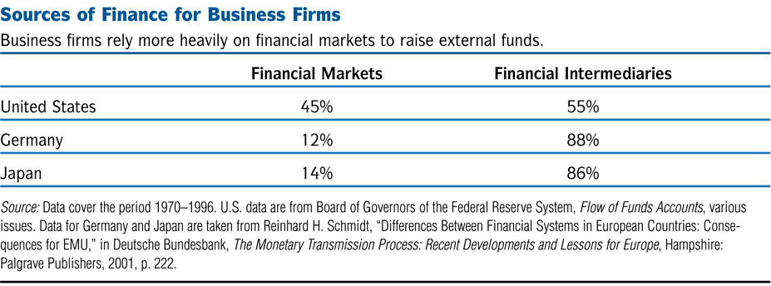
Table 11.1 Sources of Finance for Business Firms
Notes:
(

Slide 16
Some Facts
1. Indirect finance is more important than direct finance.
2. Banks are the most important source of external funds
3. Stocks are not the most important source of external financing.
4. Marketable securities are not the primary source of finance.

Slide 17
Types of Financial Markets
Monetary markets and Capital markets.
Debt markets and Equity markets.
Primary markets and Secondary markets.
Exchanges and Over-the-counter markets.
Derivatives Markets
(Refer: Mishkin 7th Chapter 2)

Slide 18
Types of Financial Markets
Money Markets
instruments traded mature in one year or less
Capital Markets
includes instruments with maturities greater than one year

Slide 19
Types of Financial Markets
Organized exchange
- A visible marketplace for secondary market transactions
Over-the-counter (OTC) market
Some transactions occur in the over-the-counter (OTC) market (a telecommunications network)

Slide 20
Types of Financial Markets
Debt Markets
treasury, corporate, mortgage-backed, money market, municipal, etc...
Equity Markets
stock markets

Slide 21
Types of Financial Markets
Primary
corporations raise funds by issuing new securities
Secondary
securities are traded among investors after they have been issued

Slide 22
Derivatives Markets
Options, futures and swaps are securities whose value is determined, or derived directly from other assets
These can be used to manage risk or to speculate

Slide 23
Types of Stock Market Transactions
Secondary market
trading existing stocks
Primary market
existing firm issues additional shares
Initial Public Offering (IPO)
privately held company offers stock to the public for the first time
called “going public”

Slide 24
The Physical Stock Exchanges
Physical exchanges
New York Stock Exchange (NYSE)
American Stock Exchange (AMEX)
Chicago Stock Exchange (CHX)
Philadelphia Stock Exchange (PHLX)
HOSE
HNX

Slide 25
Securities Traded in Financial Markets
Money market securities
Money market securities are debt securities with a maturity of one year or less
Characteristics:
Liquid
Low expected return
Low degree of risk

Slide 26
Securities Traded in Financial Markets (cont’d)
Capital market securities
Capital market securities are those with a maturity of more than one year
Bonds and mortgages
Stocks
Capital market securities have a higher expected return and more risk than money market securities

Slide 27
Securities Traded in Financial Markets (cont’d)
Bonds and mortgages
Bonds are long-term debt obligations issued by corporations and government agencies
Mortgages are long-term debt obligations created to finance the purchase of real estate
Bonds and mortgages specify the amount and timing of interest and principal payments

Slide 28
Securities Traded in Financial Markets (cont’d)
Stocks
Stocks (equity) are certificates representing partial ownership in corporations
Investors may earn a return by receiving dividends and capital gains
Stocks have a higher expected return and higher risk than long-term debt securities

Slide 29
Securities Traded in Financial Markets (cont’d)
Derivative securities
Derivative securities are financial contracts whose values are derived from the values of underlying assets
Speculating with derivatives allow investors to benefit from increases or decreases in the underlying asset
Risk management with derivatives generates gains if the value of the underlying security declines

Slide 30
The importance of financial intermediaries to securities markets

Slide 31
Obstacles to Matching Savers and Borrowers
Transactions costs: costs of buying and selling a financial instrument. → Financial intermediaries reduce transactions costs by exploiting economies of scale.
Information costs: costs to determine the creditworthiness and monitor the use of funds.
Notes:
2

Slide 32
Information Problems
Asymmetric information: one party has better information than the other.
Adverse selection: lender’s problem of sorting good risks from bad risks.
Moral hazard: (hidden action) is the risk (hazard) that the borrower will engage in activities that are undesirable (immoral) for the lender.
Notes:
3

Slide 33
Adverse Selection
Lemon problem: asymmetric information in a market leads to adverse selection.
Lemon problem raises lending costs.
Lemon problems in the bond markets lead to credit rationing.
Ref: STIGLITZ AND WEISS* (1981) Credit Rationing in Markets with Imperfect Information
Notes:
4
Lemons Problem - This is when the low quality products drive out the high quality products until only lemons (low quality products) are left in the market. Example: The market for used cars. Let's say Sarah is selling high quality used cars and is willing to sell each one for $20,000 and Ameen is selling low quality used cars for $10,000. Due to asymmetric information, most customers do not know the difference between low and high quality used cars so they take an average of the prices at $15,000 and that is the price they think is fair. Sarah will not be willing to sell her high quality used cars at this price so she will stop selling and leave the market. This process will keep happening until only low quality cars are left in the market.

Slide 34
How to solve the problems arising from adverse selection?
Private production and sale of information
Free-rider problem
Many countries set information disclosure requirements if a firm sells securities.
Financial intermediation
Collateral and net worth
(Refer: Mishkin 7th , The economics of Money, Banking and Financial Markets, Chapter 8)

Slide 35
Moral Hazard
Regulations on reporting by firms reduce the chance of fraud in equity financing.
Principal-agent problem: managers have different goals than the firm’s owners.
Moral hazard in debt financing is reduced with the use of restrictive covenants.
Notes:
5

Slide 36
Principal-Agent Problem: Solutions
Monitoring
Government regulation to increase information
Financial Intermediation
Debt Contracts

Slide 37
Information Costs and Financial Intermediaries
Financial intermediaries reduce adverse selection by specializing in gathering default risk information.
Banks’ information advantage largely accounts for their role in providing external financing.
Financial intermediaries deal with moral hazard through monitoring.
Notes:
6

Slide 38
Financial Intermediaries and Moral Hazard
Large investors often have more success in reducing the free-rider problem: they have an incentive to closely monitor how agents use their funds
When venture capital firms acquires equity in a new firm, the shares are not marketable to other investors, and the firm avoids the free-rider problem and can profit from its monitoring activities
Private equity or corporate restructuring firms acquire large blocks of equity in mature firms
Financial Intermediaries, like banks, earn a profit by acting as delegated monitors for individual savers

Slide 39
End of Chapter 1

